Slide 1

License Plate Detection
An Overview of Intelligent Systems for Vehicle Identification

Slide 2
Introduction
This presentation explores the development of an intelligent system for vehicle license plate detection and text extraction. It focuses on the use of advanced deep learning models, specifically YOLOv8, and the capabilities of Optical Character Recognition (OCR) for bilingual text extraction.

Slide 3

01
Detection Model

Slide 4
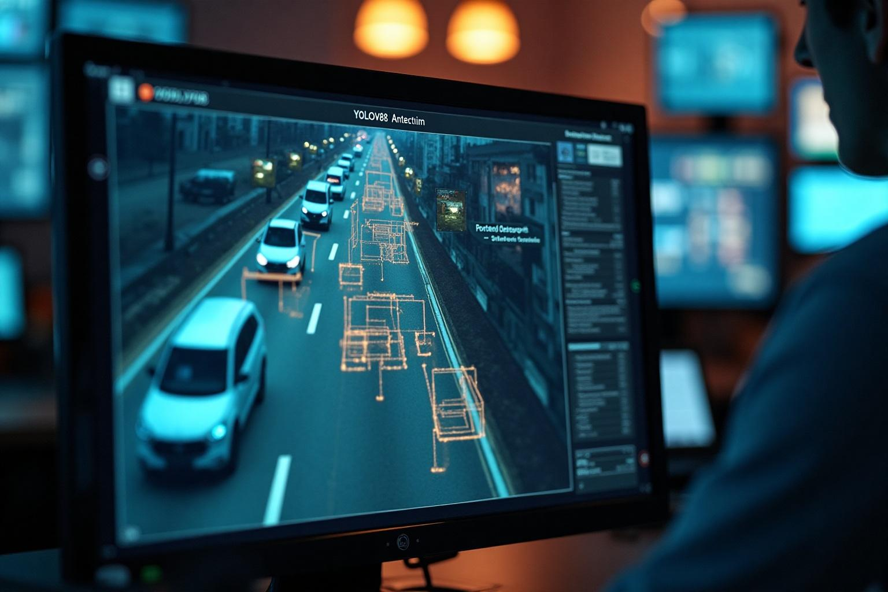
YOLOv8 for License Plate Detection
The YOLOv8 model, known for its high accuracy and speed, is utilized for detecting license plates in images. By employing a pre-trained model, the system can quickly identify bounding boxes around plates, making it highly efficient for real-time applications. This section will discuss the technical aspects of YOLOv8, including its architecture and how it improves detection rates for various styles of license plates.

Slide 5
Performance of pre-trained models
Pre-trained YOLOv8 models leverage vast datasets, which enhance their ability to generalize across different image conditions. We evaluate the performance metrics such as precision, recall, and F1 scores to understand their efficacy. Additionally, the section covers fine-tuning techniques to optimize models for specific datasets prevalent in regional license plate styles.

Slide 6
Adjusting detection parameters
Optimizing detection parameters is critical for enhancing the performance of the YOLOv8 model in license plate recognition. Key parameters include confidence thresholds, Non-Maximum Suppression (NMS) thresholds, and input image sizes. Fine-tuning these settings allows for better detection under various lighting conditions and angles, ultimately leading to improved accuracy in identifying license plates.

Slide 7

02
Text Extraction

Slide 8
Optical Character Recognition with EasyOCR
EasyOCR is an advanced OCR tool that provides high accuracy for text extraction. The system is designed to identify characters in real-time from images of license plates. The integration of EasyOCR into the vehicle identification system allows for seamless extraction of text data from detected bounding boxes. This section will delve into the operational framework of EasyOCR and how it processes images to produce textual outputs.

Slide 9
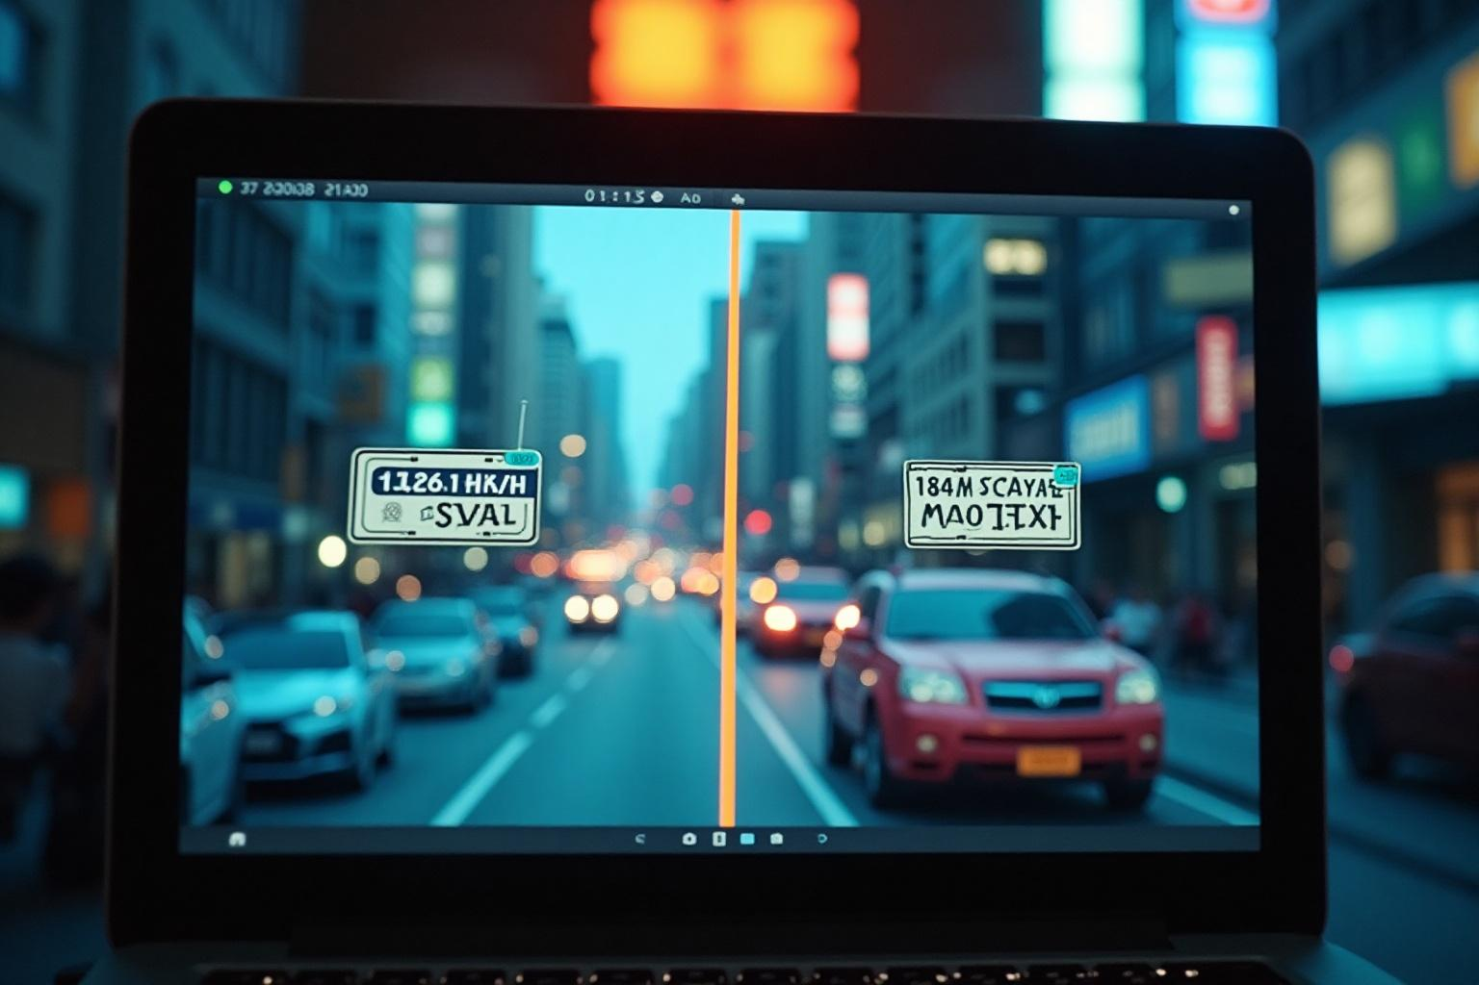
Support for Arabic and English
This system is engineered to support both Arabic and English characters, catering to a diverse range of environments and regions. The dual-language feature enhances accessibility and usability, making it suitable for applications in various geographical locations. The OCR's capability to accurately recognize and differentiate between these scripts is crucial for effective license plate reading.

Slide 10
Text cleaning techniques
To improve the quality of the extracted text, several cleaning techniques are employed. These include removing common noise such as extraneous terms (e.g., country names like 'Egypt', or 'مصر'), eliminating extra spaces, and correcting common OCR errors. By implementing these cleaning methods, the final output is made more reliable and user-friendly, ensuring that the extracted license plate data is accurate and easy to interpret.

Slide 11
Conclusions
The integration of YOLOv8 for detection and EasyOCR for text extraction presents a robust solution for automatic vehicle license plate recognition. The performance of the system can be significantly enhanced through careful adjustment of detection parameters and the implementation of effective text cleaning techniques. The capability to support both Arabic and English expands the applicability of the system across regions, making it a versatile tool for various industries.

Slide 12
Thank you!
Do you have any questions?
+00 000 000 000

